Slide 1

CMPUT 191:
Starbucks Latte Index
By Miguel Gil

Slide 2


Introduction
The index I have created is a Starbucks Latte index
Reason: Because I was curious about the different prices around the world and I was wanted Starbucks at that moment
All latte prices are in Tall sizes

Slide 3

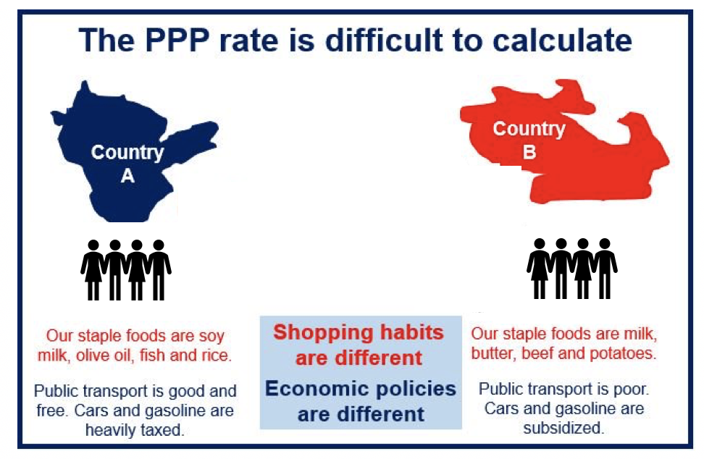
Purchasing Power Parity
It is the concept that there is an exchange rate which makes it so you can buy the same amount of goods or services in any country
Problem - Differences in taxing, importing and exporting, world events, availability, etc

Slide 4
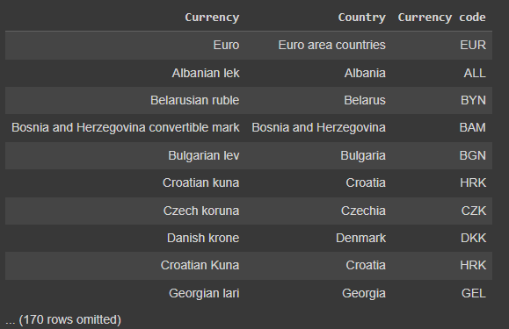
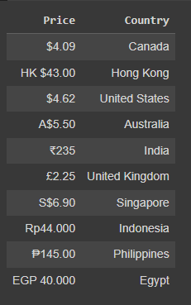
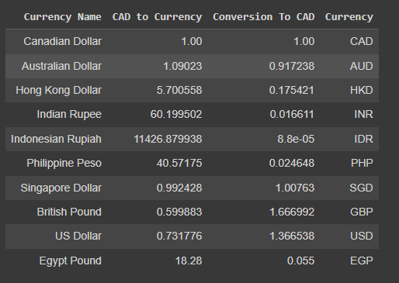
Scraping Tables
All tables I used came from the web
Even made a function specifically for scraping
Tables:
A pricing table
A currency symbol table
A currency conversion table

Slide 5
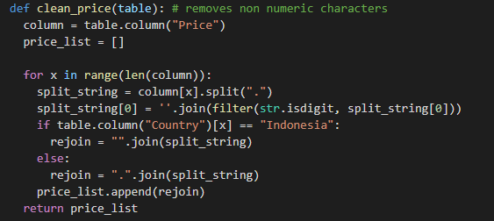
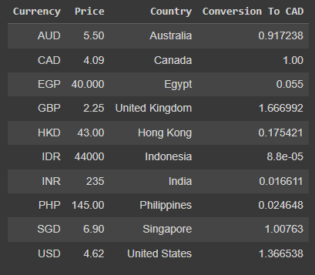
Cleaning Data
Removed the currency symbols off of the pricing with a function
Narrowed down conversion table to chosen countries
Added currency codes to conversion table
Dropped unneeded columns
Needed to convert countries in currency symbol tables

Slide 6
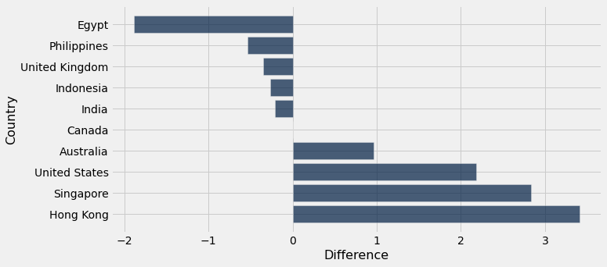
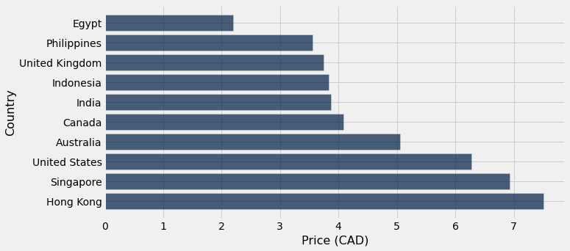
Difference Visualization
Lowest is Egypt
Highest is Hong Kong

Slide 7
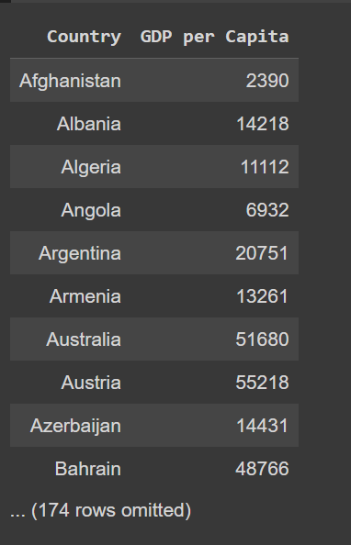
External Factor (GDP Per Capita)
GDP per capita seemed like a factor that would likely affect prices
Consumer has more money -> more luxury item purchases

Slide 8
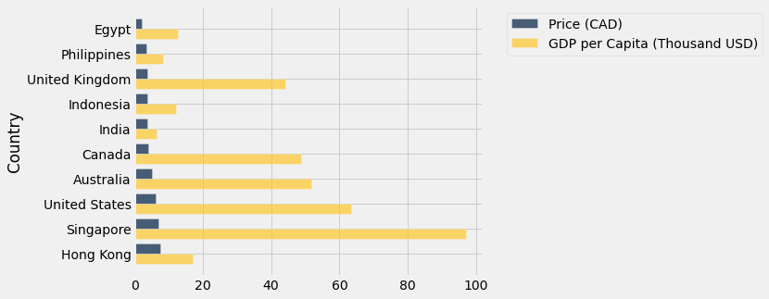
External Factor Visualization
Singapore has a very high GDP per capita
Hong Kong has the highest price but low GDP per capita
Weak trend

Slide 9
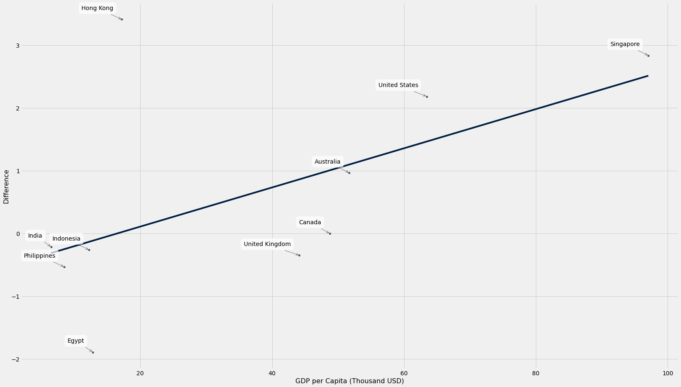
Scatter Plot and Correlation Coefficient
Very weak correlation
r coefficient = 0.552

Slide 10

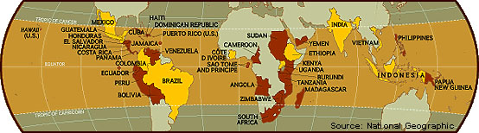
Conclusion
GDP per capita seems to have a very weak correlation to difference in pricing
Equator countries produce coffee beans -> Lower latte prices
Difficulties/Challenges:
-Finding price data in local currency
-Matching country names with currency codes (same currency countries)

